Slide 1
Buildings & Site Management Procurement Strategy
Update Q1 2025
Disclaimer:
This presentation is provided for information only
and cannot be considered as binding
Ref. F4E_D_2ABES6
1

Slide 2
Table of Contents
1. Overview of the ITER Buildings
2. Packaging Strategy
3. Overview of the Procurement Packages
4. Status of ongoing procurements
5. Future Procurements

Slide 3
1. Overview of the ITER Buildings

Slide 4
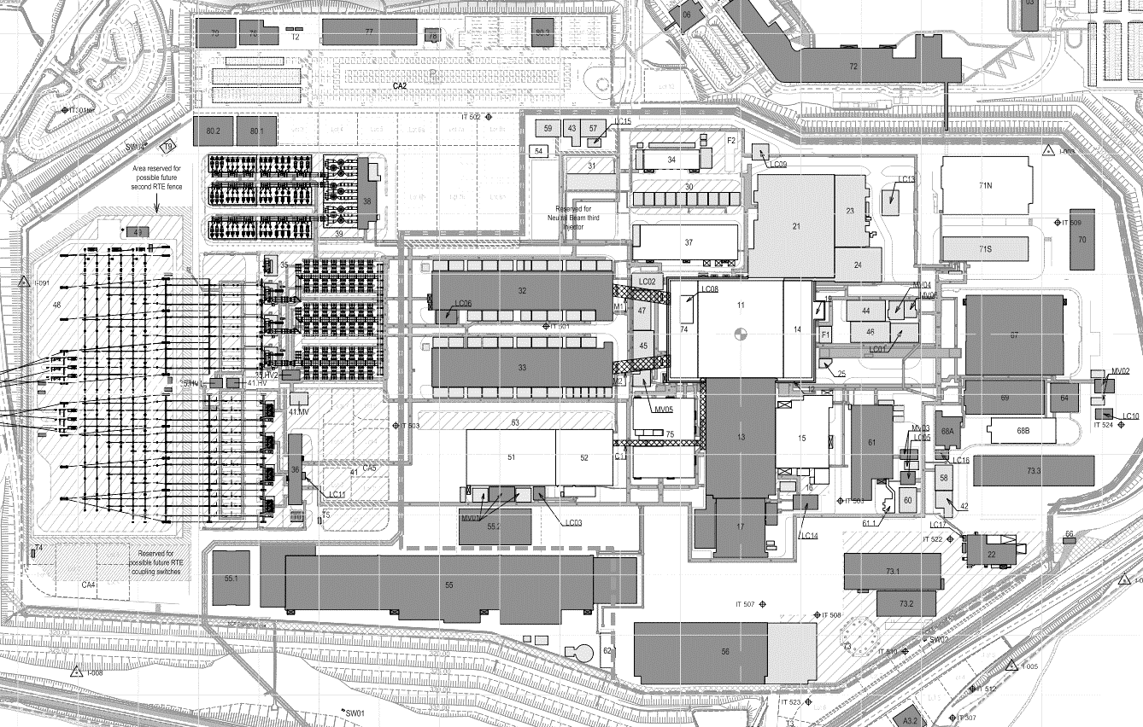
Overview of ITER Buildings
ITER Buildings
Layout
NB power supplies
Hot Cells
Control Building
Tokamak Complex
Magnet Power Conversion
Cooling Towers
Emergency distribution
Electrical distribution
Cryoplant
Assembly Hall
Site services
Fast Discharge

Slide 5
2. Packaging Strategy

Slide 6
Packaging Strategy
Procurement of Large Packages: Schedule – driven by need dates
Preliminary Works
Ongoing Works
Upcoming Works
Foundation Tokamak & Site Adaptation Works
Neutral Beam Power and Fast Discharge (34, 37,75) and Control building (71)
Long Lead - Mechanical Handling, Main Civil & Finishing, Main M&E/Services, Retrofit and Finishing Works
Emergency Electrical Power Distribution, Site Infrastructure Works
Electrical and mechanical works for the Tokamak Complex and surrounding buildings
Civil, Architectural, Finishing and Retrofitting works on existing buildings and infrastructures and some related engineering activities
Emergency distribution buildings (44-47)
Architect Engineer Services II
Miscellaneous Infrastructure, Mechanical, Electrical and Instrumentation & Control, Finishing and Retrofit Works in Non-Nuclear Buildings and Infrastructure
Emergency power distribution system - supply and installation of IP Electrical Diesel Generators
Building 14 services equipment post First Plasma;
Electrical PIC Diesel Generators, Fuel Tanks and buildings 42, 43, 57-60
Definition of new ground spectrum HCF
Hot Cell complex (21,23,24) HCC Civil Works / HCC Buildings Services/ HCC mechanical works (HCC doors, liner, lifting means)
Hot Cell Complex Architect Engineer& Engineering support for Design activities.

Slide 7
3. Overview of the Procurement Packages

Slide 8
Overview of the Procurement Packages - Layout
TB24
Electrical Diesel Generators, Fuel Tanks and buildings 59-60 (Investment Protection diesel generators)
TB17
Electrical Diesel Generators, Fuel Tanks and buildings 42 43 57 58 (Protection Important Component diesels)
TB09 & TB10
Hot Cell complex
Hot Cell Engineering
Inc B71 Control Building PIC Part
TB23 Tritium building services Nuclear Phase design / procurement
TB25 Continuation of TB11 and TB16 works infrastructure and finishing works

Slide 9
Overview of the Procurement Packages - Completed/Ongoing Contracts
TB00 | F4E-OPE-095 | Construction of the TC Seismic Isolation Pit, Supply and Installation of Anti-Seismic Bearings
TB01 | F4E-OPE-251 | Site Adaptation
TBAlpha | F4E-OPE-406 | Galleries and drainage works
TB04 | F4E-OPE-301 | Main M&E/Services
TB05 | F4E-OPE-378 | D&B Package
TB06 | F4E-OPE-428 | HV Electrical Equipment
TB07 | F4E-OPE-429 | D&B Package
TB03 | F4E-OPE-286 | Main Civil & Finishing
TB04 | F4E-OPE-301 | Main M&E/Services
TB16 | F4E-OPE-636 | Infrastructure Works (partial relaunch of TB08)
TB19 | F4E-OPE-906 | Painting and Coating for the Tokamak Complex
TB18 | F4E-OPE-996 | Completion of the Tritium Building 14
TB08 | F4E-OPE-374 | Site Infrastructure Works
TB02 | F4E-OPE-285 | Long Lead - Mechanical Handling
TB11 | F4E-OFC-755 | Retrofit and Finishing Works
TB12 | F4E-OPE-688 | Design and Build Buildings 34, 37, 75 and 71
TB13 | F4E-OPE-1003 | Emergency Electrical Power Distribution 44-47
TB20 | F4E-OPE-1099 | Tokamak Complex Doors Completion
TB21 | F4E-OMF-1107 | Electrical and mechanical works for the Tokamak Complex and surrounding buildings
TB22 Lot B | F4E-OMF-1168 | Secondary Structural works
TB22 Lot A | F4E-OMF-1168 | Primary Structural works
AE II | F4E-OPE-1496 | Architect Engineer Services II
Completed
Terminated
Ongoing

Slide 10
4. Status of ongoing procurements

Slide 11
F4E-OMF-1487 [TB25]
Ongoing
Procurement Process: Competitive Procedure with Negotiation
Contract Type: Supply
Procedure Title: Miscellaneous infrastructure, mechanical, electrical and instrumentation & control, finishing and retrofit works
Key Dates:
Issue of Pre Information Notice | Q1-2023
Issue of Invitation to Participate (step 1) | Q1-2024
Issue of Call For Tender (step 2) | Q3-2024
Receipt of Tenders | Q4-2024
Contract Award | Q1-2025
Contract Signature | Q2-2025

Slide 12
IO-F4E joint call Health & Safety (Services Contract)
Ongoing
Procurement Process led by IO
Key Dates:
Issue of Pre Information Notice (IO + F4E) | Sept-2024
Issue of Invitation to Participate (IO) | Q4-2024
Evaluation of Tenders | Q1-2025
Contract Award | Q1/Q2-2025
Contract Signature | Q2-2025

Slide 13
5. Future Procurements

Slide 14
Future Procurement Packages
TB17
PIC Electrical Diesel Generators, Fuel Tanks and buildings 42, 43, 57, 58
Building 14 services post First Plasma
Hot Cell Facility
Service Contract
Definition of new ground spectrum HCF
Legal inspection
Service Contract
TB23
TB24
IP Electrical Diesel Generators and buildings 59, 60
TB22 – Lot D
Waterproofing, Roofing, Cladding, Rainwater drainage
Engineering and Construction of Hot Cell (21), Radwaste (23) Personal Access Control Building (24) & Control Building (71) PIC Civil Works and Buildings services

Slide 15
Thank you for your attention
Follow us on:
www.f4e.europa.eu
www.twitter.com/fusionforenergy
www.youtube.com/fusionforenergy
www.linkedin.com/company/fusion-for-energy www.flickr.com/photos/fusionforenergy
For further information please contact us at
industryportal-info@f4e.europa.eu
mentioning “Buildings” in subject of your email

