Slide 1
Buildings Construction Procurement Strategy
Update Q1 2024
Disclaimer:
This presentation is provided for information only
and cannot be considered as binding
Ref. F4E_D_2ABES6
1

Slide 2
Table of Contents
1. Overview of the ITER Buildings
2. Packaging Strategy
3. Overview of the Procurement Packages
4. Status of ongoing procurements
5. Upcoming Procurements

Slide 3
1. Overview of the ITER Buildings

Slide 4
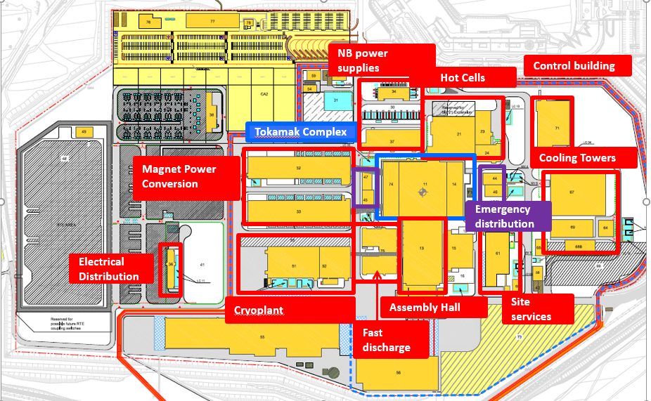
Overview of ITER Buildings
ITER Buildings
Layout

Slide 5
2. Packaging Strategy

Slide 6
Packaging Strategy
Procurement of Large Packages: Schedule – driven by need dates
Preliminary Works
Ongoing Works
Upcoming Works
Foundation Tokamak & Site Adaptation Works
Neutral Beam Power and Fast Discharge (34, 37,75) and Control building (71)
Long Lead - Mechanical Handling, Main Civil & Finishing, Main M&E/Services, Retrofit and Finishing Works
Emergency Electrical Power Distribution, Site Infrastructure Works (partial relaunch of TB08)
Painting and Coating for the Tokamak Complex
Electrical and mechanical works for the Tokamak Complex and surrounding buildings
Civil, Architectural, Finishing and Retrofitting works on existing buildings and infrastructures and some related engineering activities
Completion of Tritium Building (14)
Emergency distribution buildings (44-47)
Heavy Nuclear and Confinement Doors
Provision of Engineering and Construction Consultancy Services
Architect Engineer Services II (post 2025)
Miscellaneous Infrastructure, Mechanical, Electrical and Instrumentation & Control, Finishing and Retrofit Works in Non-Nuclear Buildings and Infrastructure
Emergency power distribution system - supply and installation of IP Electrical Diesel Generators
Building 14 services post First Plasma;
Electrical Diesel Generators, Fuel Tanks and buildings 42, 43, 57-60
Definition of new ground spectrum HCF
Hot Cell complex (21,23,24) HCC Civil Works / HCC Buildings Services/ HCC mechanical works (HCC doors, liner, lifting means)
Hot Cell Complex Architect Engineer& Engineering support for Design activities.

Slide 7
3. Overview of the Procurement Packages

Slide 8
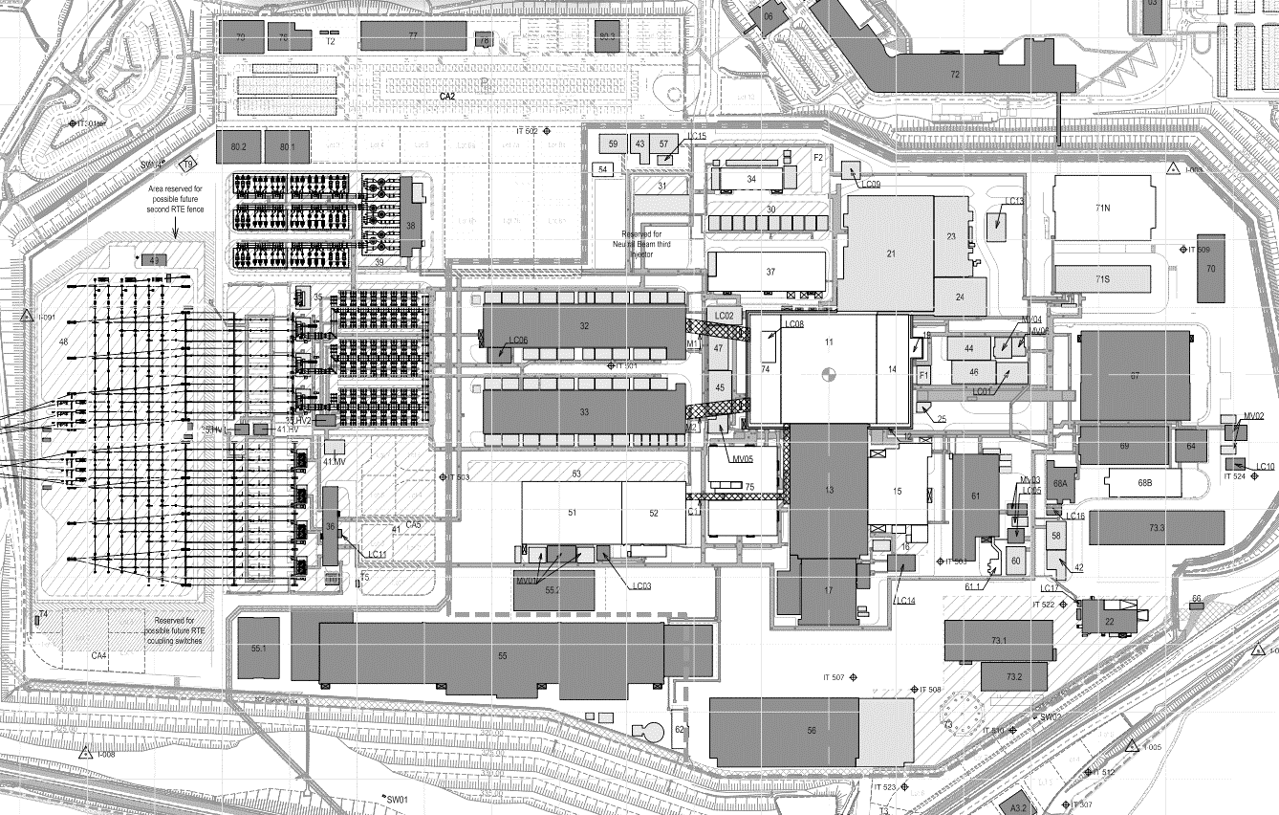
Overview of the Procurement Packages - Layout
TB24
Electrical Diesel Generators, Fuel Tanks and buildings 59-60 (Investment Protection diesel generators)
TB17
Electrical Diesel Generators, Fuel Tanks and buildings 42 43 57 58 (Protection Important Component diesels)
TB09 & TB10
Hot Cell complex
Hot Cell Integrator / Engineering
Inc B71 Control Building PIC Part
TB23 Tritium building services Nuclear Phase design / procurement
TB25 Continuation of TB11 and TB16 works infrastructure and finishing works

Slide 9
Overview of the Procurement Packages - Completed/Ongoing Contracts
TB00 | F4E-OPE-095 | Construction of the TC Seismic Isolation Pit, Supply and Installation of Anti-Seismic Bearings
TB01 | F4E-OPE-251 | Site Adaptation
TBAlpha | F4E-OPE-406 | Galleries and drainage works
TB05 | F4E-OPE-378 | D&B Package
TB06 | F4E-OPE-428 | HV Electrical Equipment
TB07 | F4E-OPE-429 | D&B Package
TB03 | F4E-OPE-286 | Main Civil & Finishing
TB08 | F4E-OPE-374 | Site Infrastructure Works
TB02 | F4E-OPE-285 | Long Lead - Mechanical Handling
TB04 | F4E-OPE-301 | Main M&E/Services
TB11 | F4E-OFC-755 | Retrofit and Finishing Works
TB12 | F4E-OPE-688 | Design and Build Buildings 34, 37, 75 and 71
TB13 | F4E-OPE-1003 | Emergency Electrical Power Distribution 44-47
TB16 | F4E-OPE-636 | Site Infrastructure Works (partial relaunch of TB08)
TB18 | F4E-OPE-996 | Completion of the Tritium Building 14
TB19 | F4E-OPE-906 | Painting and Coating for the Tokamak Complex
TB20 | F4E-OPE-1099 | Tokamak Complex Doors Completion
TB21 | F4E-OMF-1107 | Electrical and mechanical works for the Tokamak Complex and surrounding buildings
TB22 Lot B | F4E-OMF-1168 | Secondary Structural works
TB22 Lot A | F4E-OMF-1168 | Primary Structural works
Completed
Terminated
Ongoing

Slide 10
4. Status of ongoing procurements

Slide 11
F4E-OPE-1496 [AE II]
Procurement Process: Competitive Procedure with Negotiation
Contract Type: Direct contract
Procedure Title: Provision of civil engineering and construction consultancy services in connection with the ITER Project
Key Dates:
Ongoing
Issue of Pre Information Notice | Q1-2023
Issue of Invitation to Participate (step 1) | Q3-2023
Issue of Call For Tender (step 2) | Q4-2023
Receipt of Tenders | Q1-2024
Contract Award | Q3-2024
Contract Signature | Q4-2024

Slide 12
F4E-OMF-1487 [TB25]
Ongoing
Procurement Process: Competitive Procedure with Negotiation
Contract Type: Supply
Procedure Title: Miscellaneous infrastructure, mechanical, electrical and instrumentation & control, finishing and retrofit works
Key Dates:
Issue of Pre Information Notice | Q1-2023
Issue of Invitation to Participate (step 1) | Q1-2024
Issue of Call For Tender (step 2) | Q2-2024
Receipt of Tenders | Q2-2024
Contract Award | Q1-2025
Contract Signature | Q2-2025

Slide 13
F4E-OMF-1168-04 [TB22 Lot D]
Procurement Process: Competitive Procedure with Negotiation
Contract Type: FIDIC
Procedure Title: Waterproofing, Roofing, Cladding, Rainwater drainage
Key Dates:
Ongoing
Issue of Pre Information Notice | Q2-2021
Issue of Invitation to Participate (step 1) | Q3-2021
Issue of Call For Tender (step 2) | Q2-2023
Receipt of Tenders | Q1-2024
Contract Award | Q2-2024
Contract Signature | Q2-2024

Slide 14
5. Upcoming Procurements

Slide 15
Upcoming Procurement Packages
TB17
PIC Electrical Diesel Generators, Fuel Tanks and buildings 42, 43, 57, 58
Building 14 services post First Plasma
Construction of Hot Cell (21), Radwaste (23) Personal Access Control Building (24) & Control Building (71) PIC Engineering support for Civil Works and Buildings services
Hot Cell Complex
Service Contract
Definition of new ground spectrum HCF
Legal inspection
Service Contract
TB23
TB24
IP Electrical Diesel Generators and buildings 59, 60

Slide 16
TB24 – IP Electrical Diesel Generators and buildings 59, 60
Scope:
Design, supply, installation, test and commissioning of the two (2) Investment Protection (IP) emergency electrical diesel generators (EDG), one of 4MW each. The EDGs would be located in Building 59 and Building 60 respectively. Civil works for these buildings are also accounted for in the contract.
Estimated value / volume: <20M€
Estimated launch: Q1 2025
Procurement Process: Competitive Procedure with Negotiation
Contract Type: Design, supply, installation, test and commissioning
Key Dates:
Upcoming
Issue of Pre Information Notice | Q4-2024
Issue of Invitation to Participate (step 1) | Q1-2025
Issue of Call For Tender (step 2) | Q2-2025
Receipt of Tenders | Q1-2026
Contract Award | Q2-2026
Contract Signature | Q2-2026

Slide 17
Thank you for your attention
Follow us on:
www.f4e.europa.eu
www.twitter.com/fusionforenergy
www.youtube.com/fusionforenergy
www.linkedin.com/company/fusion-for-energy www.flickr.com/photos/fusionforenergy
For further information please contact us at
industryportal-info@f4e.europa.eu
mentioning “Buildings” in subject of your email

